Slide 1
Data Structures and Algorithms-I
Ananya Sarker
Assistant Prof., CSE,
BAUET

Slide 2
Course Details
CSE-2103: Data Structures and Algorithms-I 3 hours in a week, 3.00 Cr. Pre-requisite: CSE-1213
Course Content:
Introduction: Internal data representation; Abstract data types; Introduction to algorithms. Asymptotic analysis: Growth of functions, O, Ω and Θ notations; Correctness proof and techniques for analysis of algorithms; Master Theorem.
Elementary data structures: Arrays, linked lists, stacks, queues, trees and tree traversals, graphs and graph representations, heaps, binary search trees.
Graph Traversals: DFS, BFS, Applications of DFS and BFS.
Sorting: heapsort, merge sort, quicksort; Data structures for set operations.
Methods for the design of efficient algorithms: Divide and conquer, greedy methods, dynamic programming.

Slide 3
Basic Terminology
Data: It is simply a value or set of values
Data Item: refers to single unit of values
Entity: It is something that has certain properties or attributes Example: In an organization Employee is an entity, its attributes are (ID, Name, Age, Sex, Salary) etc.
Information: refers to meaningful or processed data.
Example: 21 is simply a data but if it is an age then it is an information
Field: One attribute refers to a field Record: Several fields constitute a record File: Several records constitute a file Database: Several file makes a database
Key: a filed that can uniquely identify a record (ID, Roll, SSN etc)

Slide 4
Basics of Data Structure
What is Data Structure :
Data Structure is a way to organized data in such a way that it can be used efficiently.
The logical or mathematical model of a particular organization of data is called data structure

Slide 5
Basics of Data Structure
Types of DS
Data Structure
Primitive
Non-Primitive
Char Integer Float double
Linear
Non-Linear
Array Stack Queue Link List
Tree Graph

Slide 6
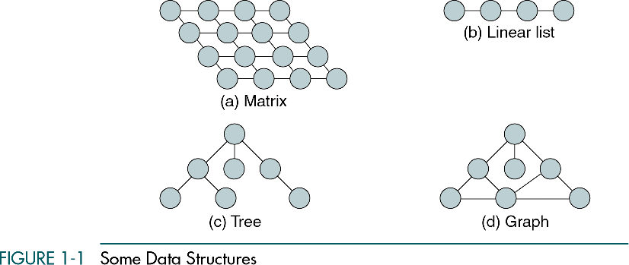

Example of Data Structure
In simple language, Data Structures are structures programmed to store ordered data, so that various operations can be performed on it easily.

Slide 7
Linear vs Non-Linear Data Structure
Linear data structure: A linear data structure traverses the data elements sequentially, in which only one data element can directly be reached. Ex: Arrays, Linked Lists
Non-Linear data structure: Every data item is attached to several other data items in a way that is specific for reflecting relationships. The data items are not arranged in a sequential structure. Ex: Trees, Graphs

Slide 8
Data Structure Operation
Four Basic Operations
Traversing:: Accessing each record exactly once so that certain items in the record may be processed.
Searching:: Finding the location of the record(s)
with a given key value/conditions.
Inserting:: Adding a new record to the structure.
Deleting:: Removing a record from the structure.
Two Special Operations
Sorting:: Arranging the records in some logical order.
Merging:: Combining records from different files.

Slide 9
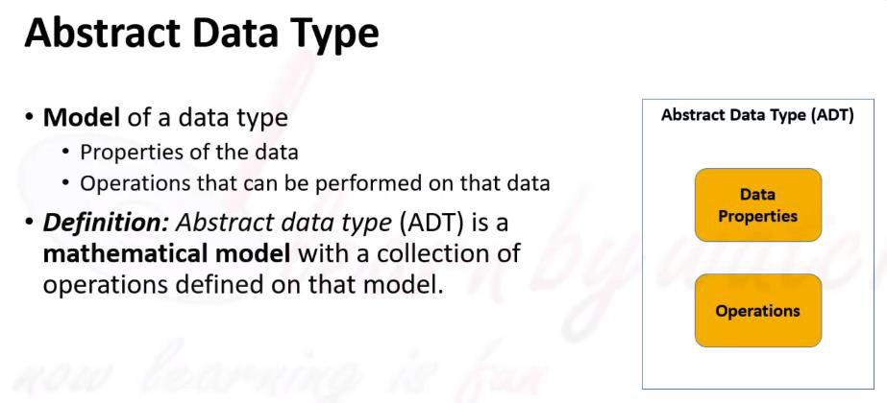


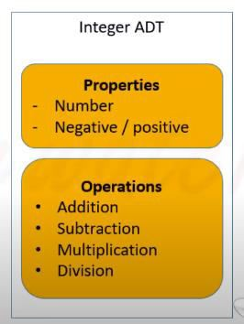
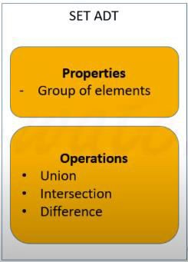
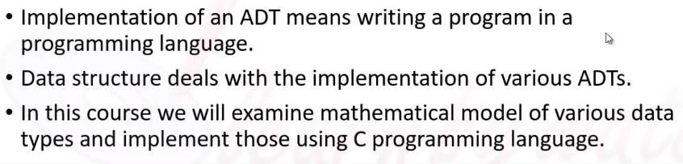

Slide 10
we will learn about ADT but before understanding what ADT is let us consider different in-built data types that are provided to us. Data types such as int, float, double, long, etc. are considered to be in-built data types and we can perform basic operations with them such as addition, subtraction, division, multiplication, etc. Now there might be a situation when we need operations for our user-defined data type which have to be defined. These operations can be defined only as and when we require them. So, in order to simplify the process of solving problems, we can create data structures along with their operations, and such data structures that are not in-built are known as Abstract Data Type (ADT).

Slide 11
ALGORITHMS AND FLOWCHARTS
A typical programming task can be divided into two phases:
Problem solving phase
produce an ordered sequence of steps that describe solution of problem
this sequence of steps is called an algorithm
Implementation phase
implement the program in some programming language

Slide 12
Steps in Problem Solving
First produce a general algorithm (one can use pseudocode)
Refine the algorithm successively to get step by step detailed algorithm that is very close to a computer language.
Pseudocode is an artificial and informal language that helps programmers develop algorithms. Pseudocode is very similar to everyday English.

Slide 13
Characteristics of an Algorithm
Not all procedures can be called an algorithm. An algorithm should have the below mentioned characteristics
Unambiguous − Algorithm should be clear and unambiguous. Each of its steps (or phases), and their input/outputs should be clear and must lead to only one meaning.
Input − An algorithm should have 0ne or more well defined inputs.
Output − An algorithm should have 1 or more well defined outputs, and should match the desired output.
Finiteness − Algorithms must terminate after a finite number of steps.
Feasibility − Should be feasible with the available resources.
Independent − An algorithm should have step-by-step directions which should be independent of any programming code.

Slide 14
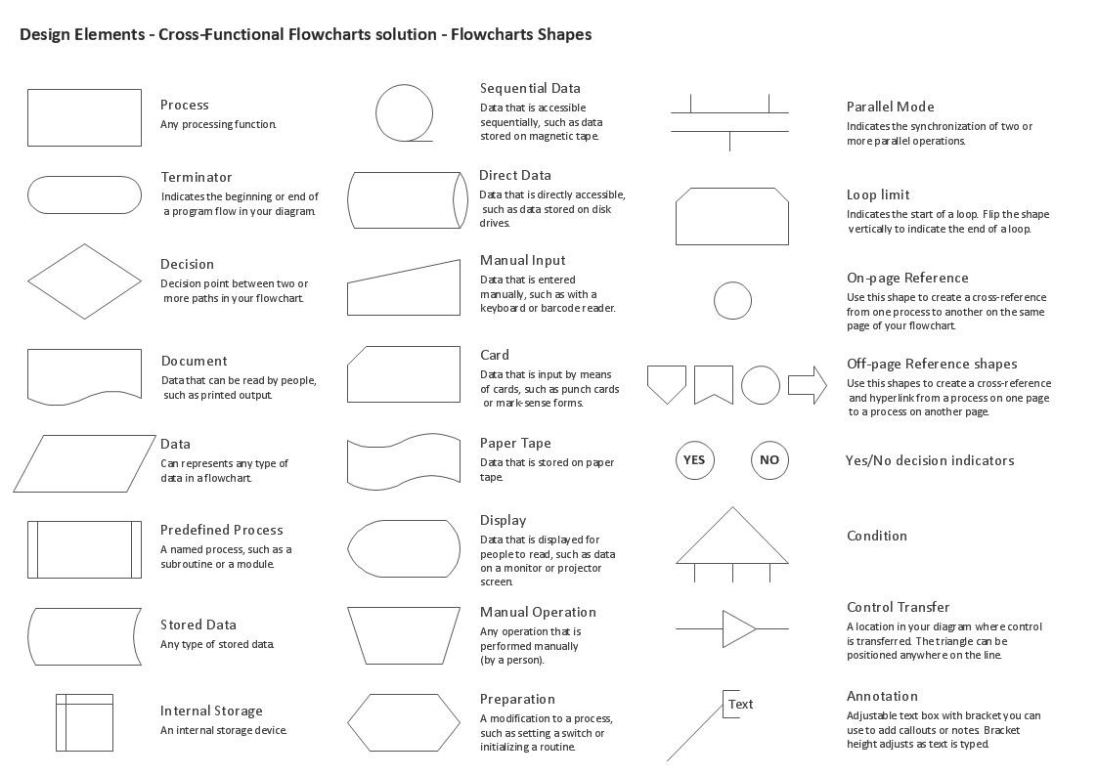
Algorithm & Flow Chart
Algorithm is a step-by-step solution of problem Flowchart is a pictorial presentation of an algorithm

Slide 15
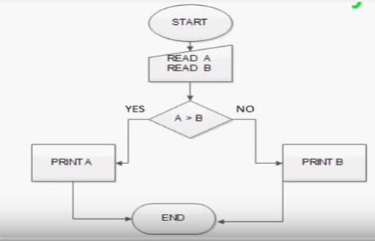
Examples of Flow Chart
Prob: Find the bigger between two numbers.

Slide 16
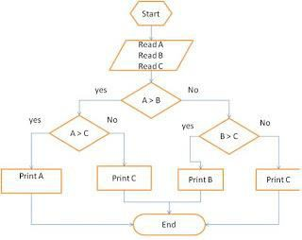
Examples of Flow Chart
Prob: Find the biggest among three numbers.

Slide 17
Algorithms: Complexity, Time-Space Tradeoff
Complexity:: The complexity of an algorithm is the function which gives the running time and/or space in terms of input size.
Time-Space Trade-Off in Algorithms: A tradeoff is a situation where one thing increases and another thing decreases. It is a way to solve a problem in:
Either in less time and by using more space, or
In very little space by spending a long amount of time.
The best Algorithm is that which helps to solve a problem that requires less space in memory and also takes less time to generate the output.

Slide 18
Algorithm Complexity
Suppose X is an algorithm and n is the size of input data, the time and space used by the Algorithm X are the two main factors which decide the efficiency of X.
Time Factor − The time is measured by counting the number of key operations such as comparisons in sorting algorithm
Space Factor − The space is measured by counting the maximum memory space required by the algorithm.
The complexity of an algorithm f(n) gives the running time and / or storage space required by the algorithm in terms of n as the size of input data.

Slide 19
Space Complexity
Space complexity of an algorithm represents the amount of memory space required by the algorithm in its life cycle. Space required by an algorithm is equal to the sum of the following two components −
A fixed part that is a space required to store certain data and variables, that are independent of the size of the problem. For example simple variables & constant used, program size etc.
A variable part is a space required by variables, whose size depends on the size of the problem. For example dynamic memory allocation, recursion stack space etc.

Slide 20
Asymptotic Analysis
Asymptotic analysis of an algorithm, refers to defining the mathematical boundation/framing of its run-time performance. Using asymptotic analysis, we can very well conclude the best case, average case and worst case scenario of an algorithm.
Asymptotic analysis are input bound i.e., if there's no input to the algorithm it is concluded to work in a constant time. Other than the "input" all other factors are considered constant.

Slide 21
Asymptotic analysis refers to computing the running time of any operation in mathematical units of computation. For example, running time of one operation is computed as f(n) and may be for another operation it is computed as g(n²). Which means first operation running time will increase linearly with the increase in n and running time of second operation will increase exponentially when n increases. Similarly the running time of both operations will be nearly same if n is significantly small.

Slide 22
Usually, time required by an algorithm falls under three types −
Best Case − Minimum time required for program execution.
Average Case − Average time required for program execution.
Worst Case − Maximum time required for program execution.

Slide 23
Asymptotic Notations
Following are commonly used asymptotic notations used in calculating running time complexity of an algorithm.
Ο Notation
Ω Notation
θ Notation

Slide 24
Big Oh Notation, Ο
The Ο(n) is the formal way to express the upper bound of an algorithm's running time.
It measures the worst case time complexity or longest amount of time an algorithm can possibly take to complete.

Slide 25
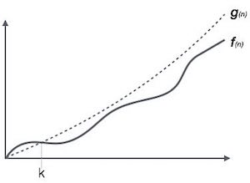
For example, for a function f(n)
Ο(f(n)) < { g(n) : there exists c > 0 and n₀ such that f(n) ≤ c.g(n) for all n > n₀. }

Slide 26
Omega Notation, Ω
The Ω(n) is the formal way to express the lower bound of an algorithm's running time.
It measures the best case time complexity or best amount of time an algorithm can possibly take to complete.

Slide 27
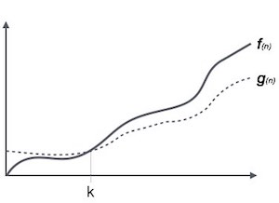
For example, for a function f(n)
Ω(f(n)) ≥ { g(n) : there exists c > 0 and n₀ such that g(n) ≤ c.f(n) for all n > n₀. }

Slide 28
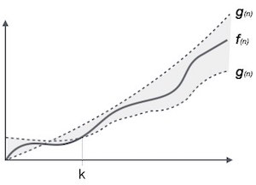
Theta Notation, θ
The θ(n) is the formal way to express both the lower bound and upper bound of an algorithm's running time. It is represented as following −
θ(f(n)) = { g(n) if and only if g(n) = Ο(f(n)) and g(n) = Ω(f(n)) for all n > n₀. }

Slide 29
Common Asymptotic Notations
constant | − | Ο(1)
logarithmic | − | Ο(log n)
linear | − | Ο(n)
n log n | − | Ο(n log n)
quadratic | − | Ο(n²)
cubic | − | Ο(n³)
polynomial | − | n^{Ο(1)}
exponential | − | 2^{Ο(n)}

Slide 30


Slide 31
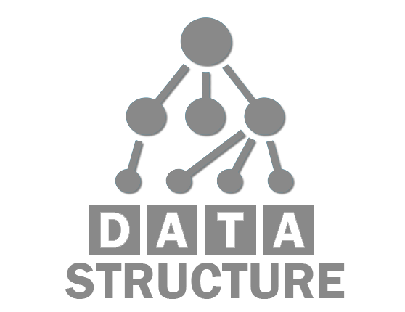
















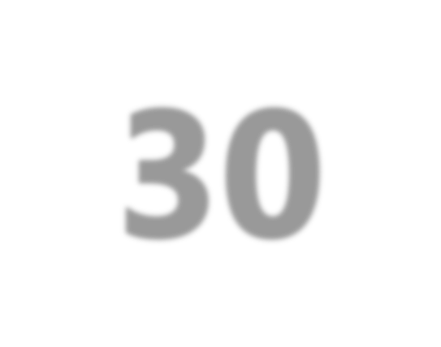







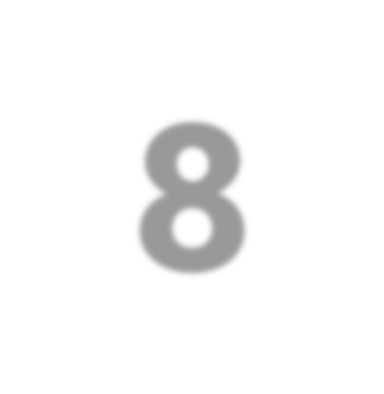

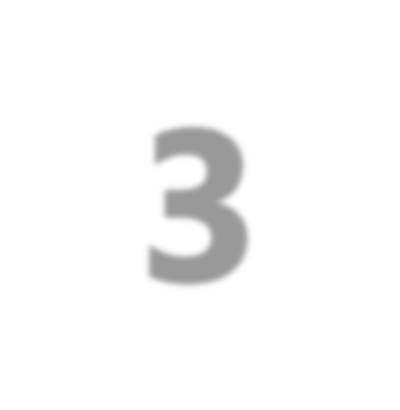


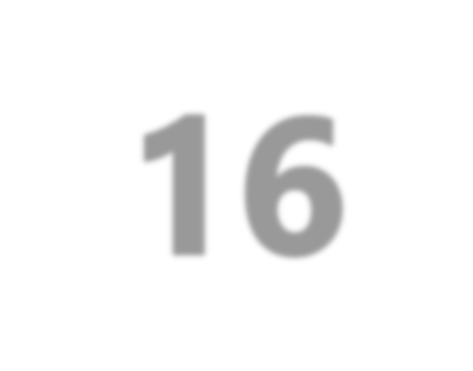
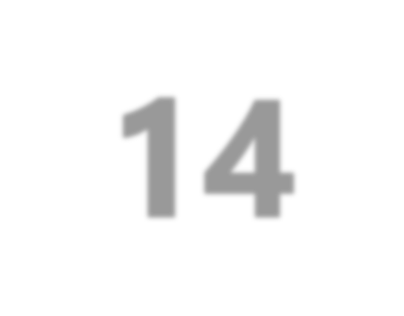



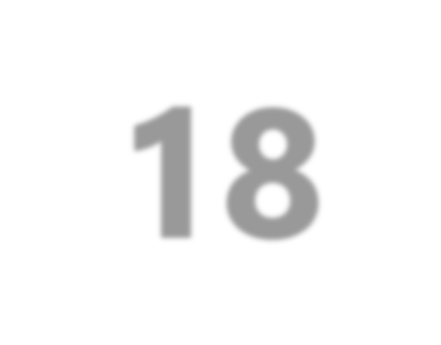
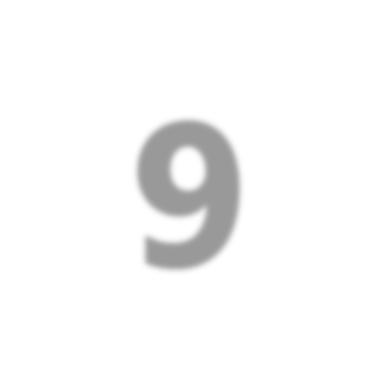

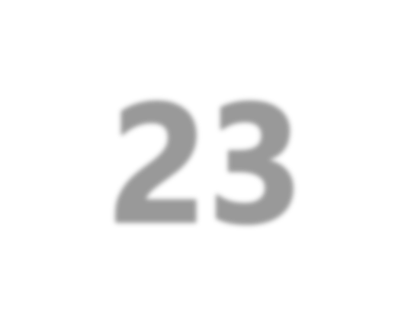
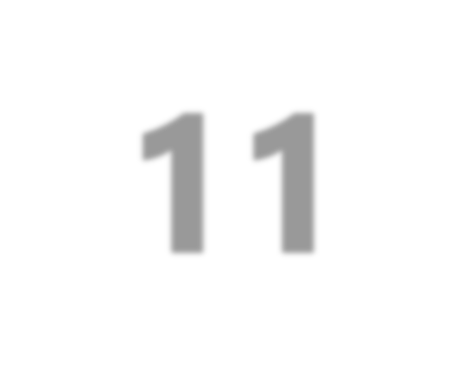

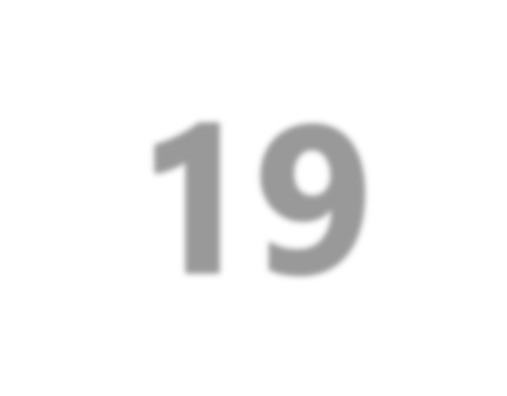



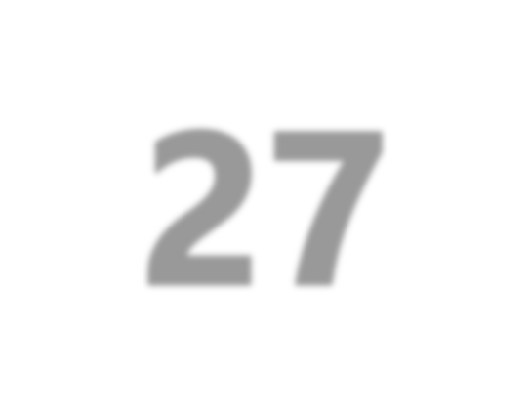
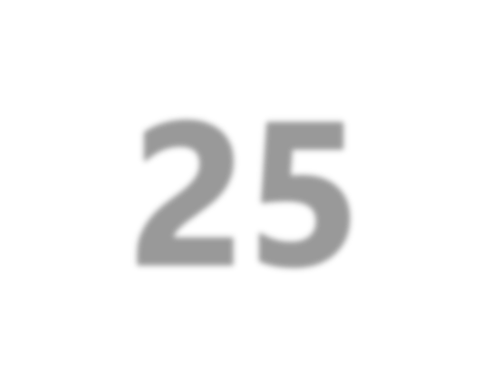

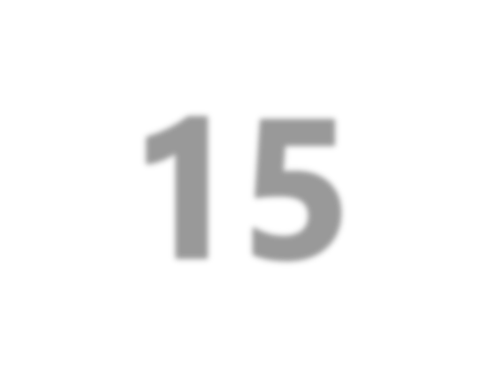
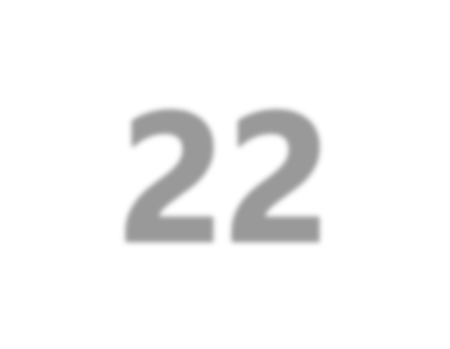
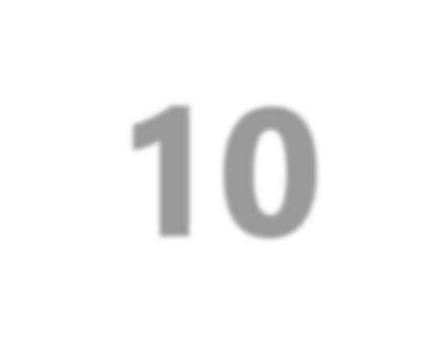
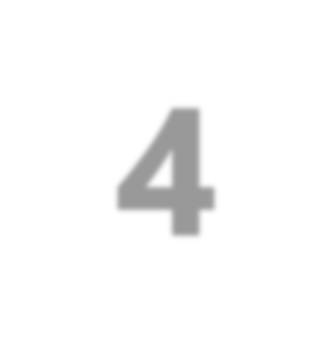
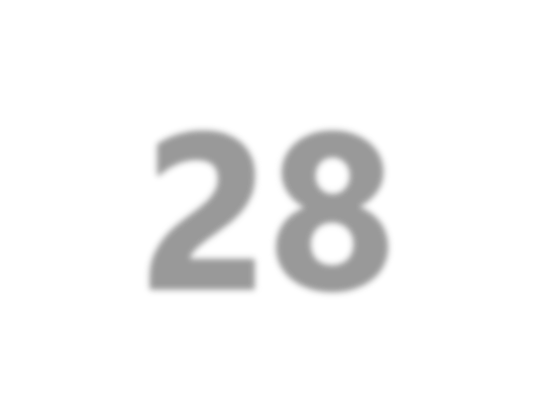
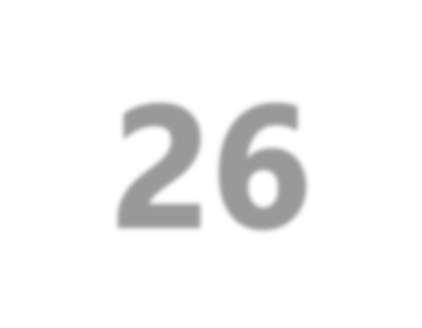

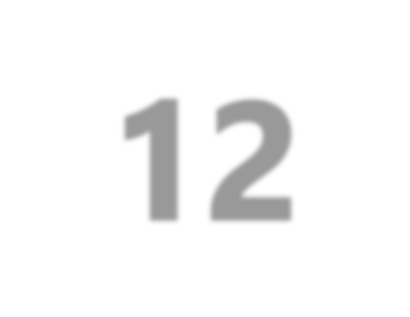
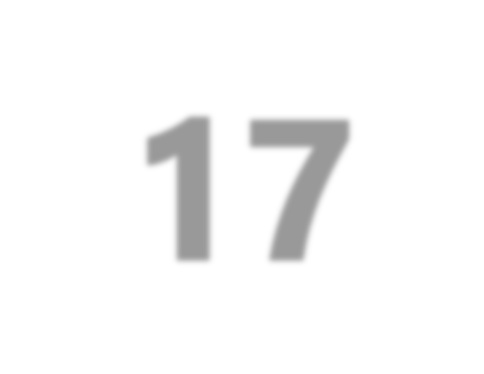
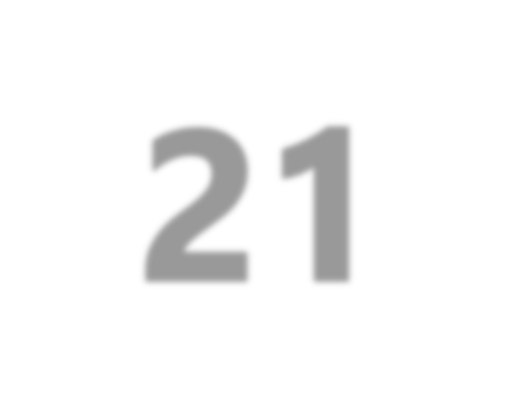
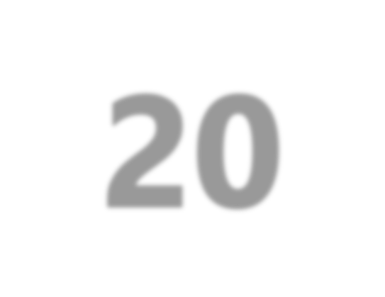
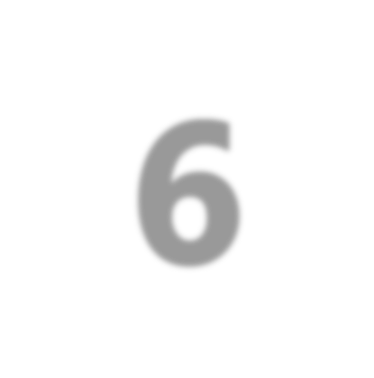
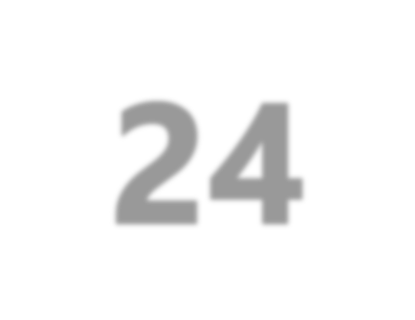
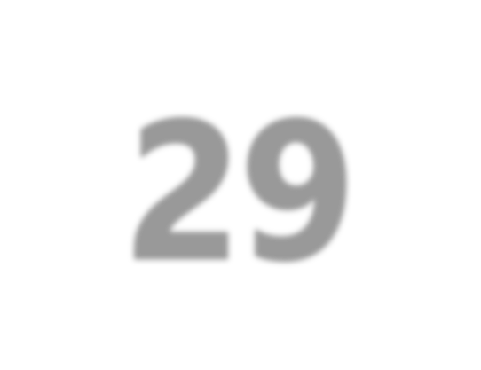
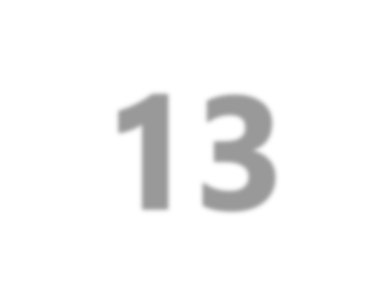



























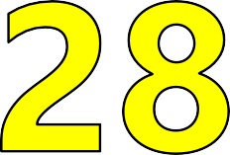












Q1: A(n) _ has different properties
A Field
B C
Entity
File
D Record

Slide 32
Q2: Which in NOT a primitive data structure?
A Boolean
B C
Arrays
Integer
D Character

Slide 33
Q2: Which is a non-linear data structure?
A Arrays
B C D
List
Stack
Graph

Slide 34
Q4: Which operation accesses each
record | exactly | once so that
contain | item may | be processed?
A Inserting
B C D
Deleting
Searching
Traversing

Slide 35
Q5: _ involves arranging the records in a logical order
A Merging
B C
Sorting
Searching
D Traversing

Slide 36

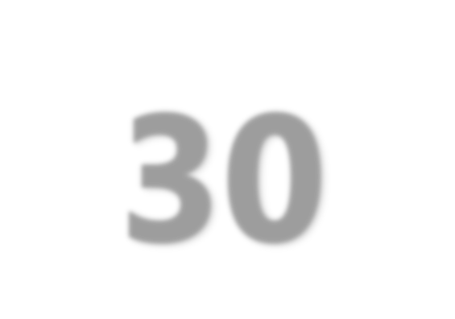
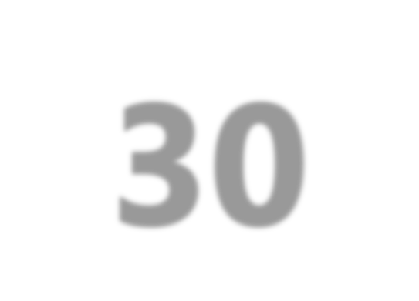

Q6: Complexity is a function
of
A B C
Input data size
Output data size
Amount of time taken
D Total space taken

Slide 37
Q7: Which symbol is used for decision making?
A B C D

